Slide 1




Are You Connected?
Utah Valley University, Charles Knadler, CS2300, Discrete Math
Notes:
“Education companies can no longer ignore that you, the students, are demanding a more effective, more efficient, less expensive education. We want to partner with you to make all of that happen, and let you know that we are here for YOU to serve your learning needs.”

Slide 2
How to Earn a Better Grade in this Course
Using McGraw-Hill Education digital products to improve your performance
The specific resources available for this course and how they will improve your grade
Where to purchase your course materials
Notes:
The technology that is available for your course is Connect Plus.

Slide 3
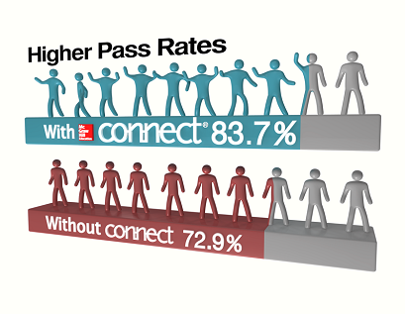
What Connect Means to You
Helps you manage your time most effectively
Works with you to customize a plan for achieving greater performance
Provides feedback and analysis to support your learning needs
Notes:
Connect is a platform for you to access your course materials anytime and anywhere
Connect gives you access to your assignments, eBook (within Connect Plus), videos, animations, LearnSmart and more
Rather than just a homework management tool, or a place for your instructor to send you emails, Connect is a platform that integrates all different learning focused resources to make life easier, and learning better for students.
Included in Connect which I’ll show to you a little later if we have time are your assignments, personalized study guides, learn smart, your ebook, and recorded lectures from your professor for you to review. If you utilize all of the resources on Connect, you’ll be better prepared to understand what you need to learn and pay attention to when you get to class.
Explain graphic

Slide 4
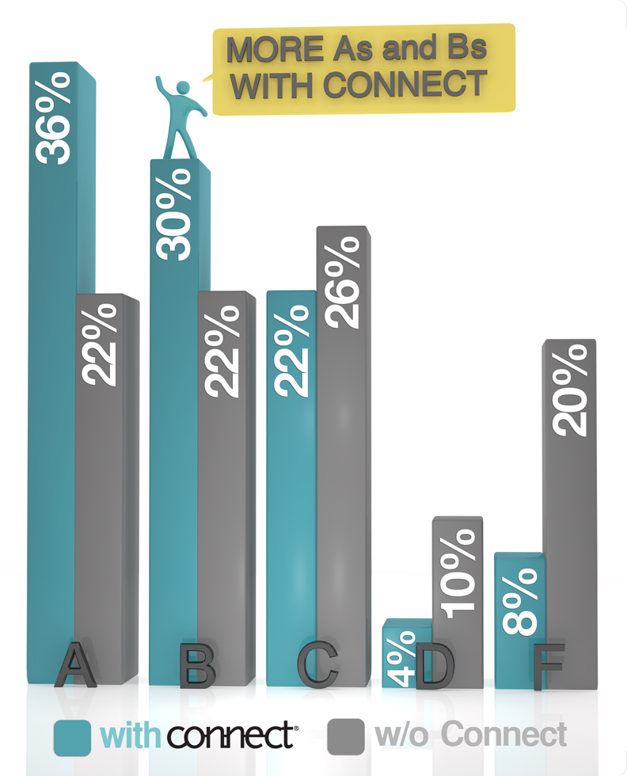
Improved Performance with Connect
Students who use Connect are more successful in the course and receive higher grades than their peers not using Connect.

Slide 5
You have choices!
Go Fully Digital
Connect Plus – Best Option
All digital, includes the Connect eBook and access to assignments
Most include LearnSmart and SmartBook 2.0
Visit your campus bookstore
Connect Plus
Includes everything within Connect Plus

Slide 6
Connect Plus
The Best Value and Experience
Part of your grade: Your instructor is requiring Connect for this course.
Portable: Access all of the required online assignments, an eBook, and study resources from any computer.
Price: Connect Plus is typically HALF the price of the printed textbook.

Slide 7
Your Required Materials
Rosen, Connect Plus Math 1 Semester Access Card for Discrete Math and its Application
9780077353520
Notes:
So what do you need to get started.
Here we have the book that your professor will be using to teach the course, the connect product (that comes with Learnsmart) paired with it, as well as the URL you need to log into your class site

Slide 8
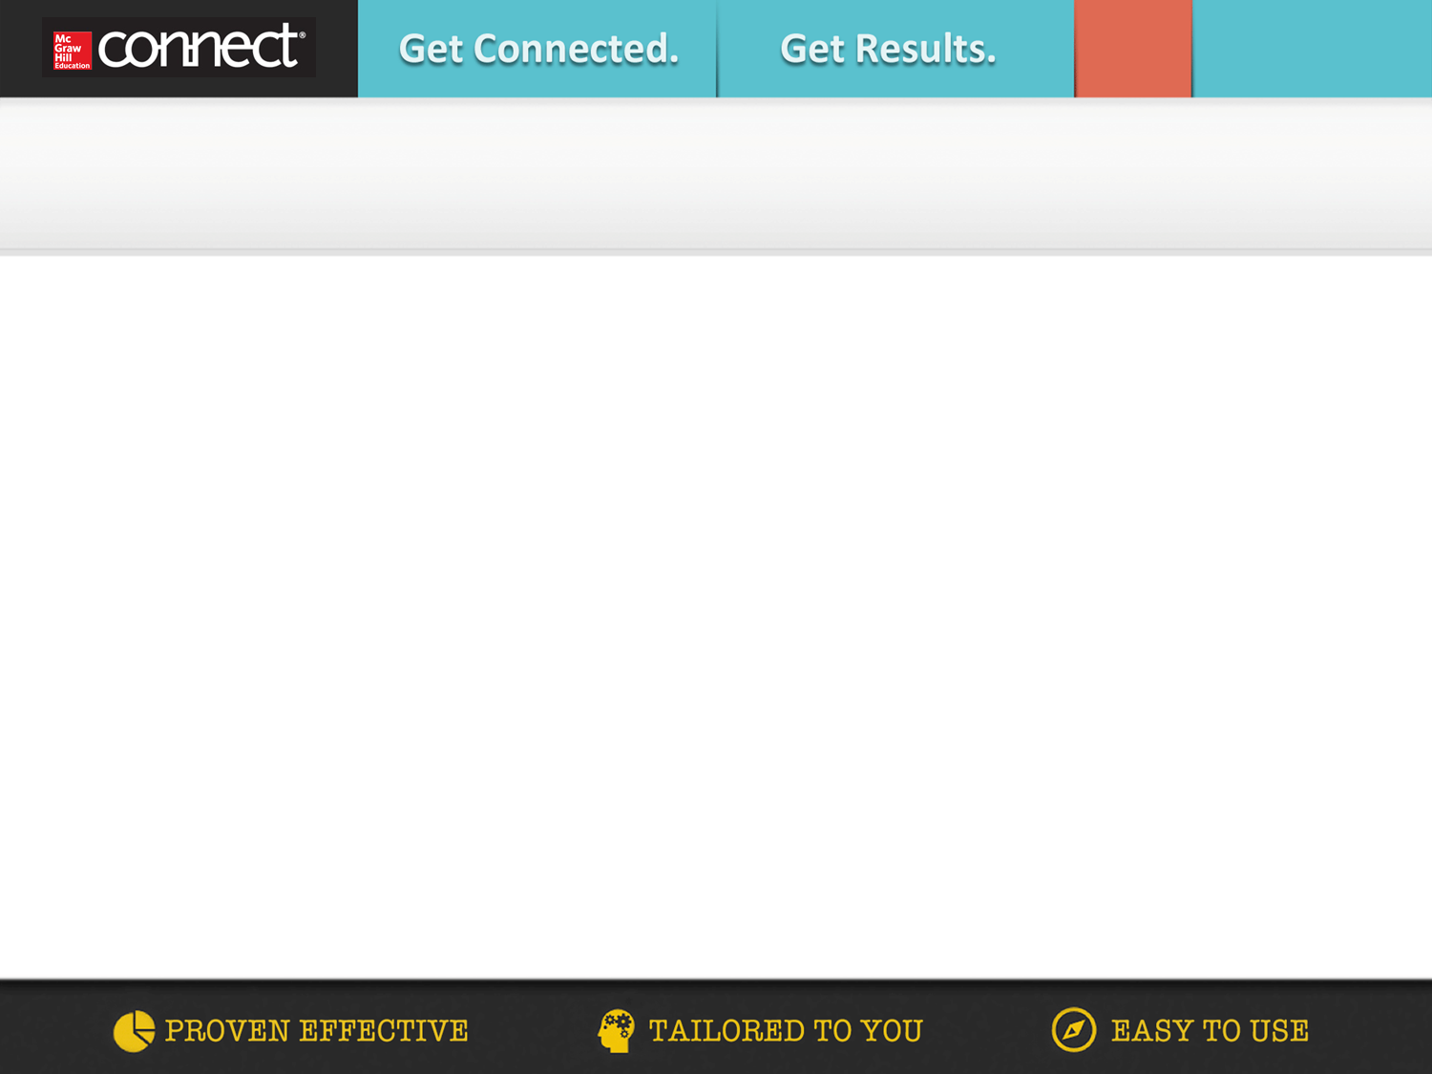

Get started in 7 easy steps!
Log in to your institution’s Canvas site and navigate to your course.
Click on the McGraw-Hill Campus link within your course. This link may be found in a block on the right side of the course home page.
Click
Review and agree to the terms of service.
Enter your e-mail address and click “find my account.”
If you haven’t used connect before, click “Create a new Connect account and complete your registration.” Complete all fields in registration form.
If you have used connect before, enter your password and click “Log in”
Enter your access code, select “Buy Online,” or you can “Start courtesy access” if you don’t have an access code.
Enter a contact e-mail address and click “Complete my Registration.”

Slide 9
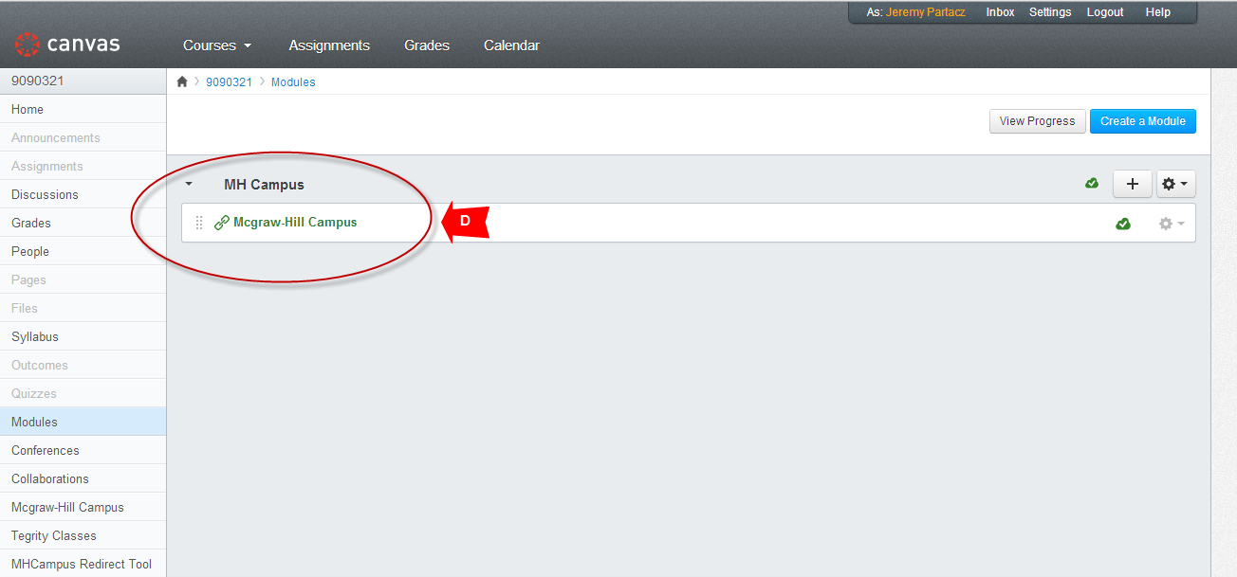

Slide 10
The Results
YOU learn more efficiently
YOU get the help you need, when you need it
YOU learn more, and earn higher grades

Slide 11

Become a MGH Student Ambassador!
The Student Ambassador program allows individuals to:
Learn: grow your network and gain leadership experience
Collaborate: partner with your MHE sales team to drive digital awareness on your campus
Build your personal brand: hone your skills in public speaking, problem solving, and creativity by interacting with faculty, students, and MHE executives
Make an Impact: work directly with MHE to assist in product development and be part of the future of digital education
Please visit
bit.ly/mheambassadors
for more information

Slide 12
Need Help?
Tech Support & FAQ:
Call: (800) 331-5094
Email & Chat: www.mhhe.com/support
Monday - Thursday ● 8 AM - 11 PM
Friday ● 8 AM - 6 PM
Saturday ● 10 AM - 4 PM
Sunday ● 12 PM - 11 PM
(All times Central)
Find more support at: www.connectstudentsuccess.com
NOTE: If you contact your instructor with a technical question, you will be asked to provide a case number from tech support before your concern is escalated.
Notes:
Our goal is to provide you with the service you need to get the most out of Connect. Our customer support is here to assist you with any technical issues you might be having. If you’re having trouble with anything – accessing a page, submitting an assignment, etc. -- use these resources before going to your professor. We have many people dedicated to helping you with all things technical. Keep the cards/stickers we passed out somewhere you can’t lose them, and use these resources whenever you need.
www.mhhe.com/support has a new chat functionality; You can browse through connect student success for anything else you might need; FAQs, etc.

